Slide 1
What is 4-H
Photography

Slide 2
Who can tell me what 4-H is?
An out of school fun educational experience
Over 200 different projects!
Opportunity to make new life long friends
Learn about things your passionate about!
Learn life skills
Try something new!

Slide 3
4-H Photography Project
Photography introduces you to a useful hobby and a career field; giving you educational guidance as you develop skills in taking and using pictures. You will also gain an appreciation of photography as an art, science and communication tool that will help to observe and appreciate your surroundings. Photography is an excellent way to record events, ideas and situations for later use.
Level 1: Activities cover four main areas: Equipment, Lighting, Composition, and Skill Building.
Level 2: Activities build on the four main areas from Level 1 (Equipment, Lighting, Composition, and Skill Building) and include topics such as the Rule of Thirds, Selecting a Lens, and Panorama.
Level 3: Activities build on the four main areas from Levels 1 and 2 (Equipment, Lighting, Composition, and Skill Building) and include topics such as Smartphone Exposure Tips, Low Light Challenges, and Studio Portraits.

Slide 4
5 Basic Photography Elements
Composition
Lighting
Focus
Storytelling
Creativity

Slide 5
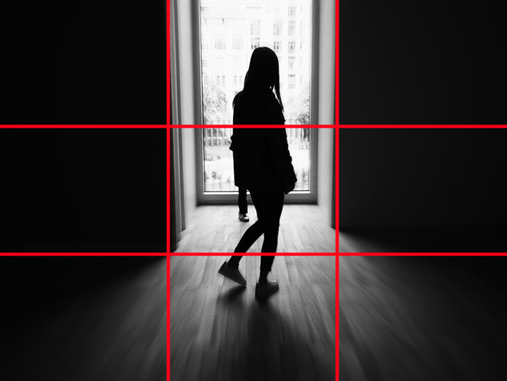
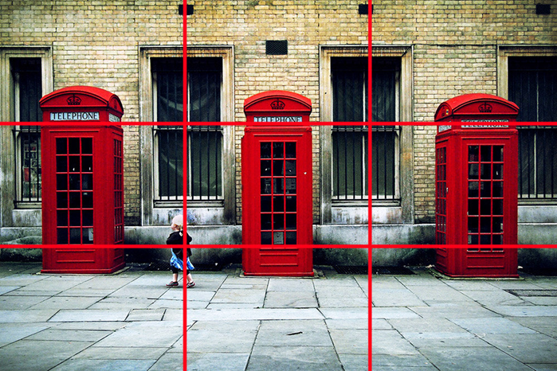
Composition - Rule of Thirds
Rule of Thirds - Divide the frame into thirds both horizontally and vertically. Place key elements along these lines or at their intersections.

Slide 6
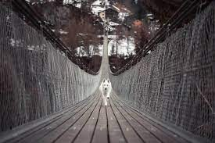
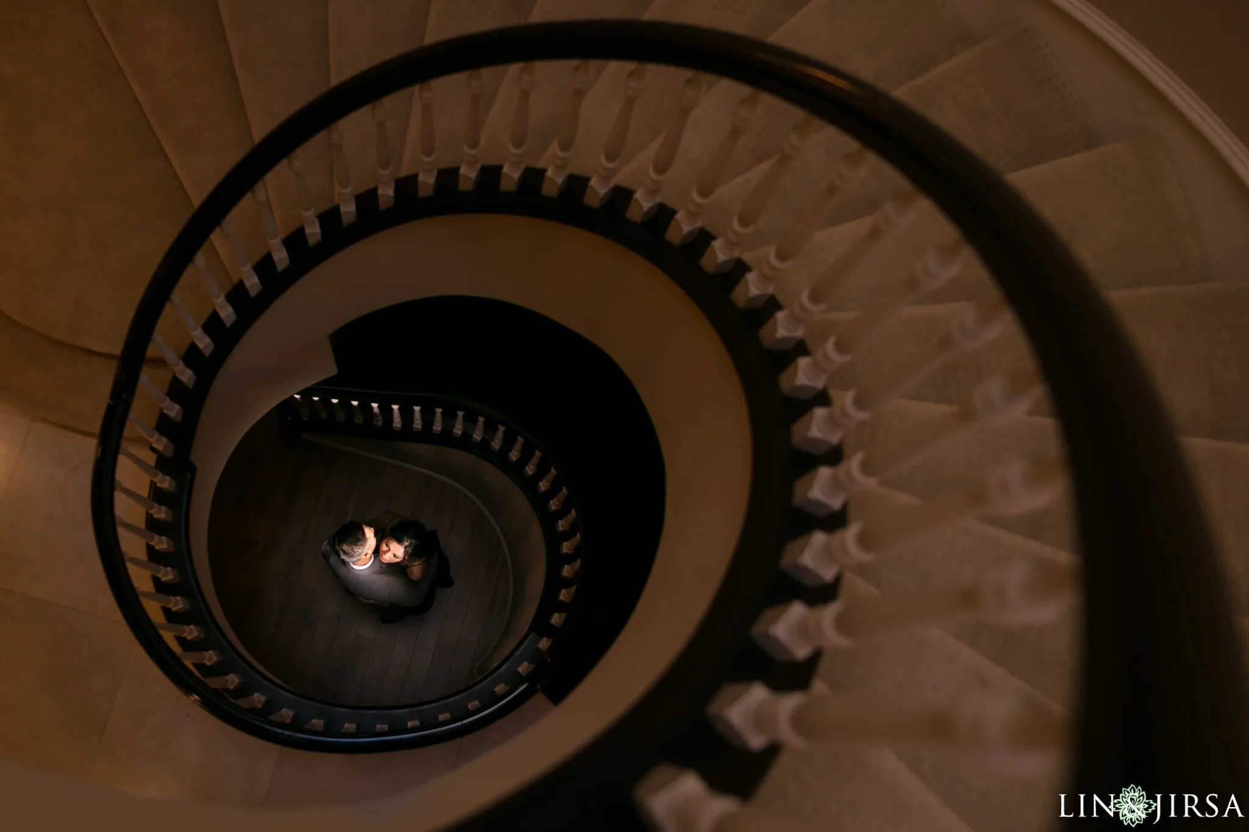
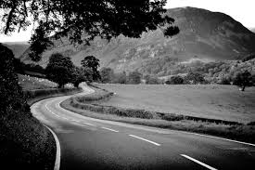
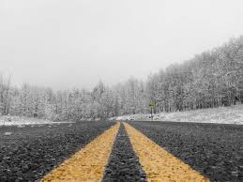
Composition - Leading Lines
Leading Lines - Use lines within the image (e.g., roads, fences) to guide the viewer's eye toward the main subject.

Slide 7
Lighting
Quality of Light - Pay attention to the direction, intensity, and color of light.
Shadows – avoid lighting or objects that casts a shadow

Slide 8
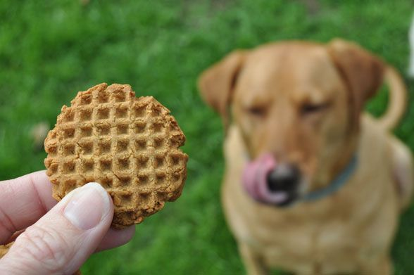
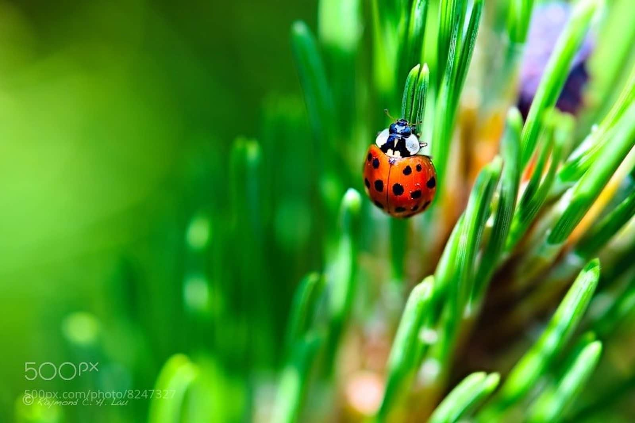
Focus
Focus - Making a person, flower, animal or other object the focal point of the photo by isolating your subject from the background

Slide 9
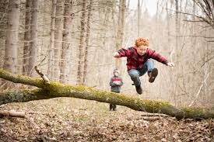
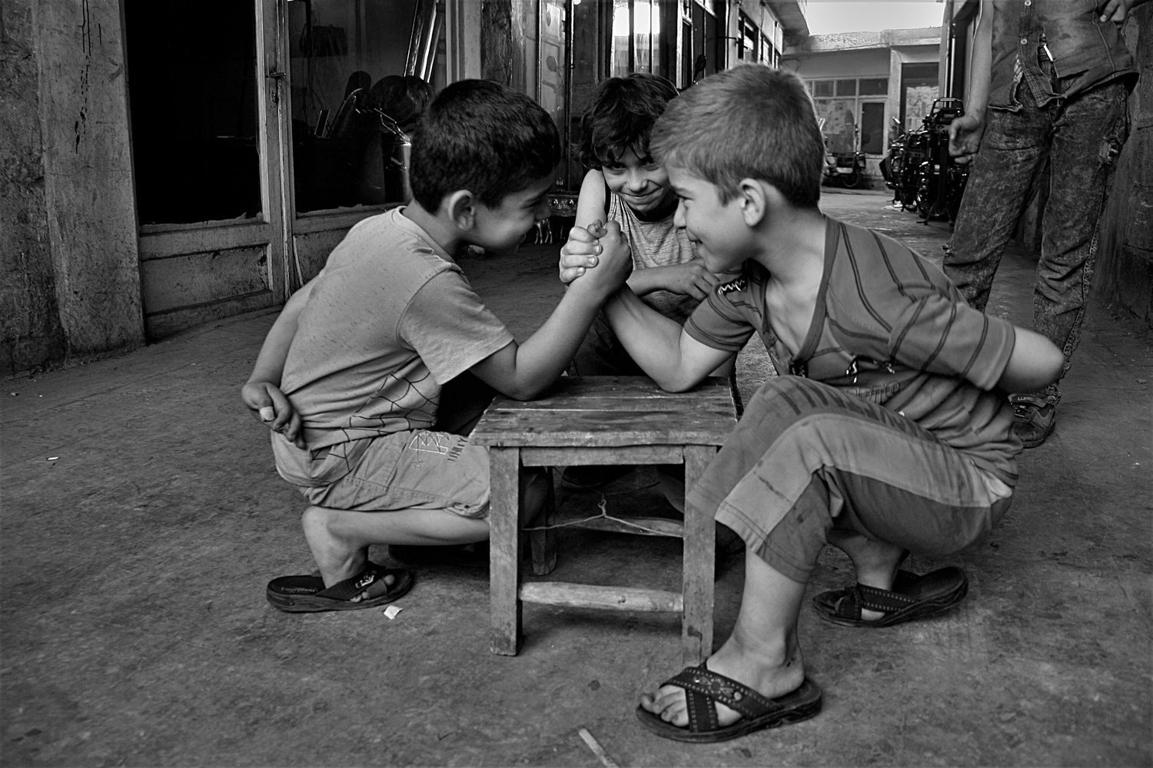
Story Telling Examples
Narrative - Aim to tell a story or evoke emotions through your images.
Capturing Emotion - Focus on expressions and moments that convey feelings.

Slide 10
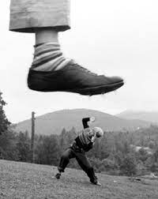
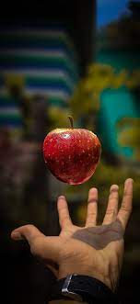
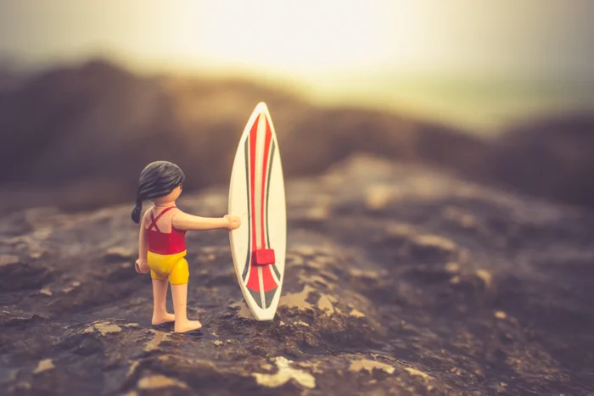
Be Creative!
Creativity – Have fun with it, try new things and find your personal style!

Slide 11
Share the photos you took!

Slide 12
Photos through gaps or holes
Use in camera filters
Get up close to your subject
Put your camera in a unique position
Pick your focus point
Rule of thirds
Tell a story

Slide 13
Supplies
Lego people
Flowers
Light – string lights
Snowflakes

